Slide 1
JPEG Image Compression
蔡意維 陳博彥

Slide 2
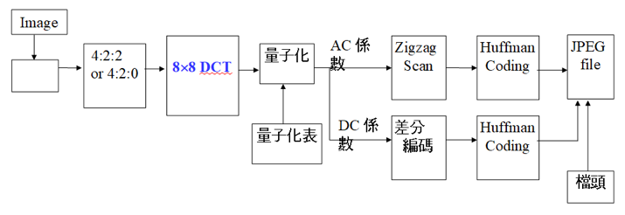
Recap
RGB
to
YCbCr

Slide 3
Outline
Part 1: Changing DCT block size
Part 2: Making compression harder

Slide 4
Part 1
Changing DCT Block Size

Slide 5
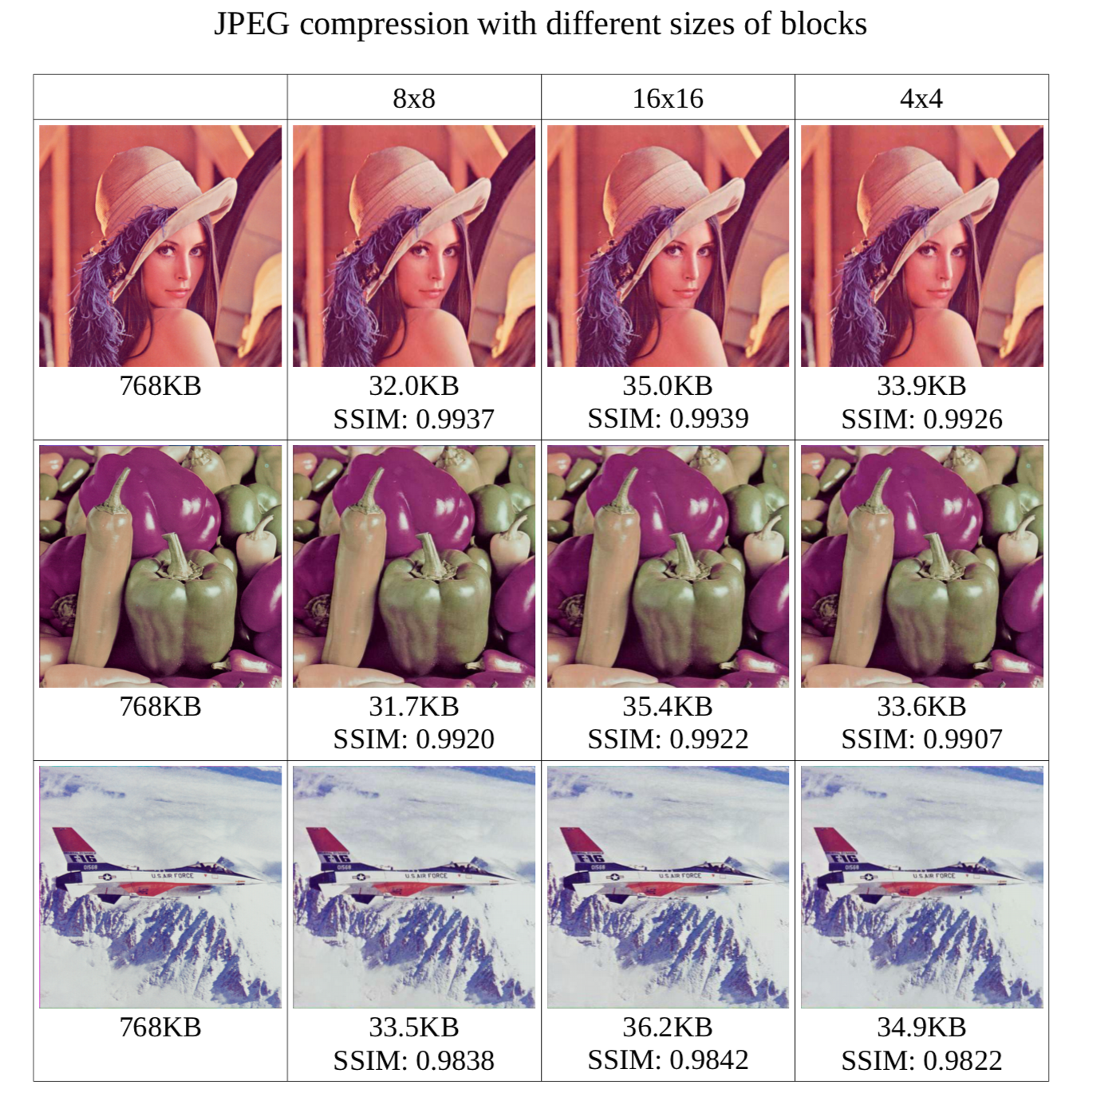

Slide 6
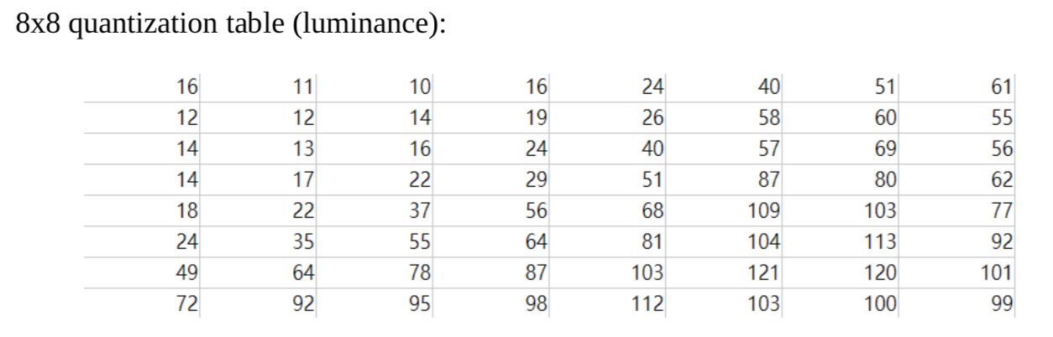
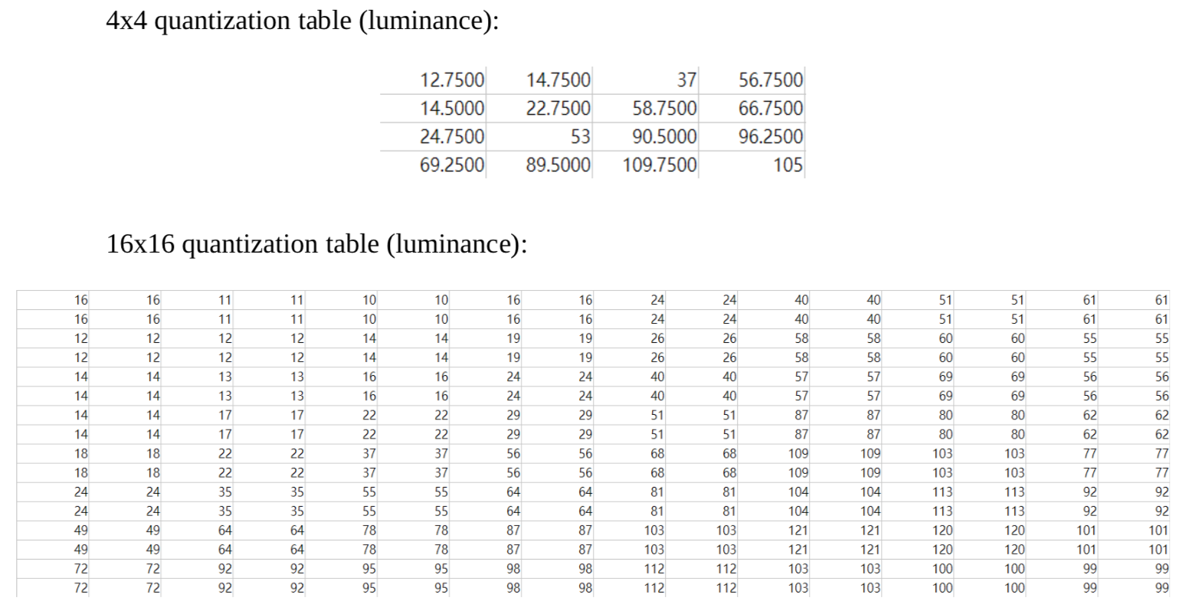

Slide 7
Part 2
Making Compression Harder

Slide 8
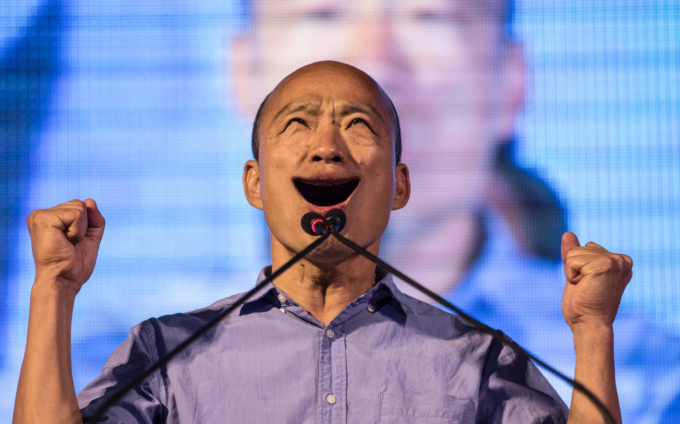

Objective
For a given image, modify it to make the JPEG file size as big as possible while preserving certain visual quality.
korean_fish.jpg
100 kb
korean_fish.jpg
150 kb

Slide 9
Problem Formulation
Given image
Maximize JPEG_size( image’ )
Subject to Visual_similarity( image’, image ) > threshold

Slide 10
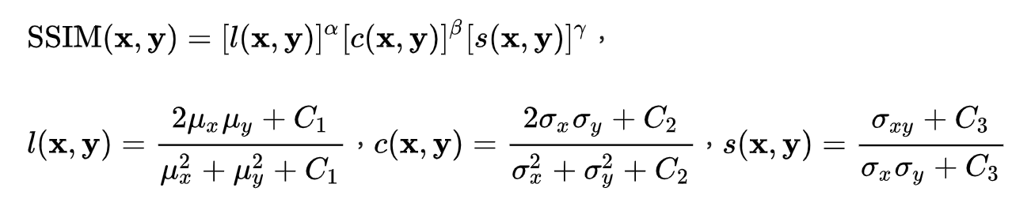
Visual Quality
Visual_similarity( image’, image ) > threshold
Structural similarity index (SSIM)
SSIM(x,x)=1, -1<=SSIM(x,y)<=1

Slide 11
Approach
Simulated Annealing
Initial temperature T>0, annealing rate 0 < r < 1 image=original_image while ( time_used < time_limit ): for 1 <= i <= P: image’ = add_noise ( image ) if SSIM( image’, original_image ) > threshold: improvement = JPEG_size(image’) - JPEG_size(image) if improvement > 0: image=image’ else: image=image’ for probability exp( improvement/T ) T=r*T return image

Slide 12
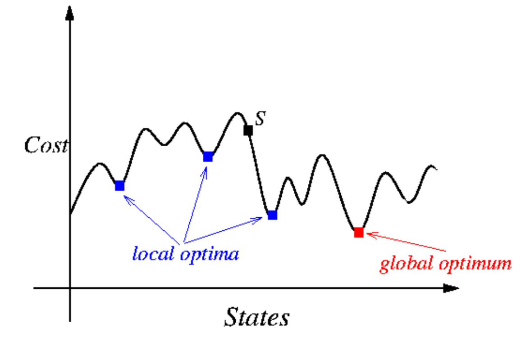

Slide 13
Approach
Simulated Annealing
Initial temperature T>0, annealing rate 0 < r < 1 image=original_image while ( time_used < time_limit ): for 1 <= i <= P: image’ = add_noise ( image ) if SSIM( image’, original_image ) > threshold: improvement = JPEG_size(image’) - JPEG_size(image) if improvement > 0: image=image’ else: image=image’ for probability exp( improvement/T ) T=r*T return image
Gaussian noise

Slide 14
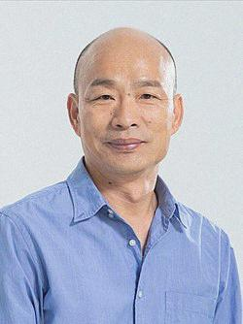
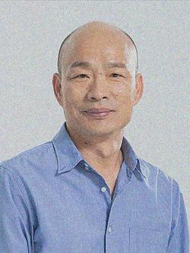

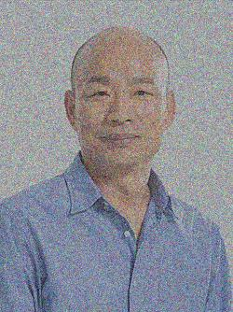
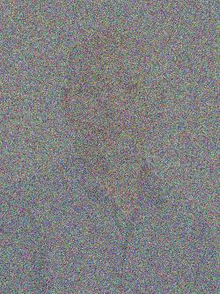
Results
Similarity | 1 | 0.9 | 0.8 | 0.7 | 0
File size (kb) | 13 | 17 | 21 | 28 | 31

Slide 15
Thank You!

